Slide 1


Airbnb Dataset Analysis
This presentation explores the Airbnb dataset, revealing insights into key features, geographical trends, and host characteristics. We'll analyze categorical and numerical data to uncover valuable information about the platform and its users.

Slide 2
PROJECT OVERVIEW
Dataset Processing
SQL Database Integration
Power BI Dynamic Dashboard
Load the dataset into a pandas DataFrame and clean the data
Prepare the cleaned data for loading into an SQL database
Create an SQL Database and create an appropriate tables to store cleaned data.
Use python to load cleaned
Data from pandas into SQL Databse
Create a connection between Power BI and SQL Database
Create a Power BI dashboard that showcases essential insights and updates in real time as the SQL database data changes.

Slide 3
Columns
room_type
multi
metro_dist
lat
The type of the room accommodation.
Dummy variable if the listing belongs to the hosts with 2-4 offers.
Distance from nearest metro station in km.
Latitude of the listing location.
lat
dist
Longitude of the listing location.
Distance from city center in km.
person_capacity
biz
guest_satisfication_overall
Dummy variable if the listing belongs to the hosts with more than 4 offers..
The maximun number of guests.
Overall rating of the listing.
attr_index_norm
Normalized attraction index(0-100).
host_is_superhost
Cleanliness_rating
rest_index_norm
bedrooms
Cleanliness rating.
Restaurant index of the listing location.
Dummy variable if the listing belongs to the hosts with more than 4 offers..
Dummy variable for superhost status.

Slide 4
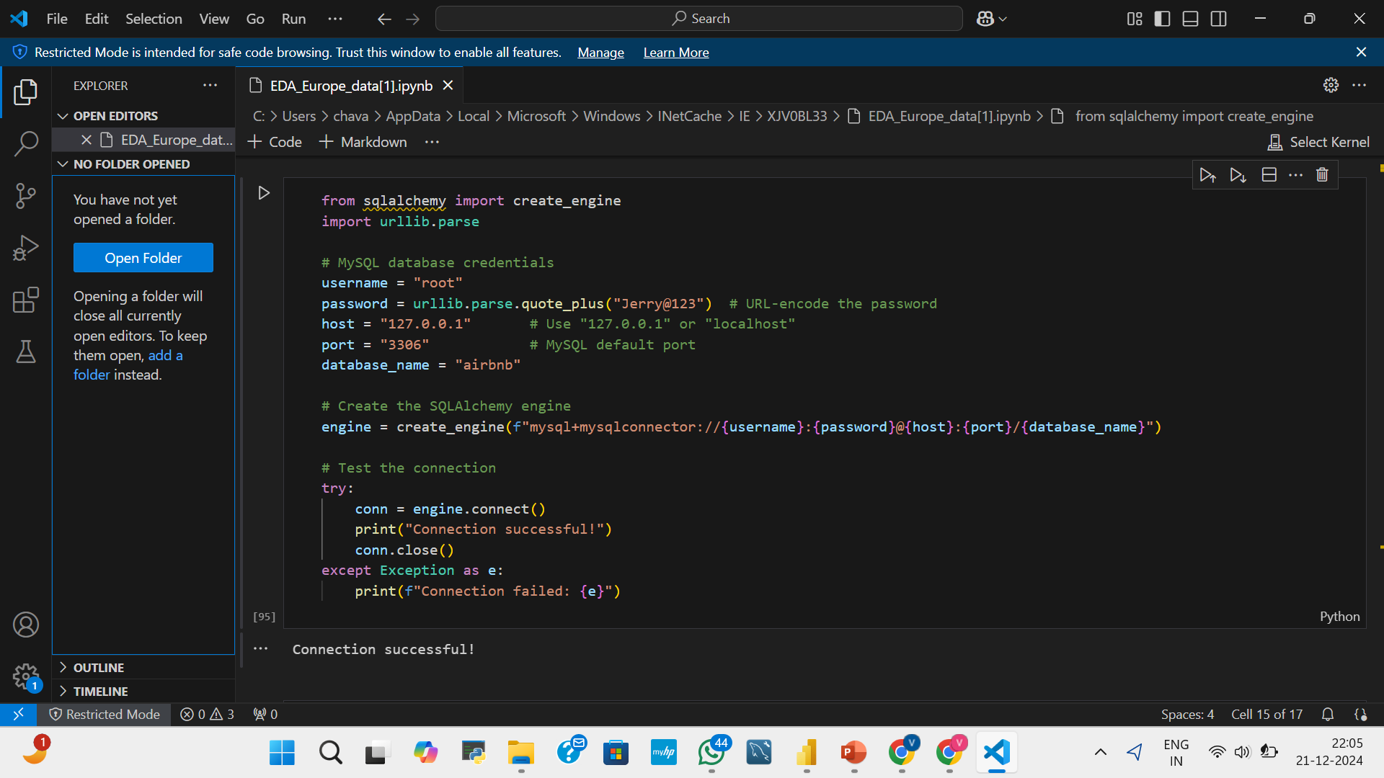
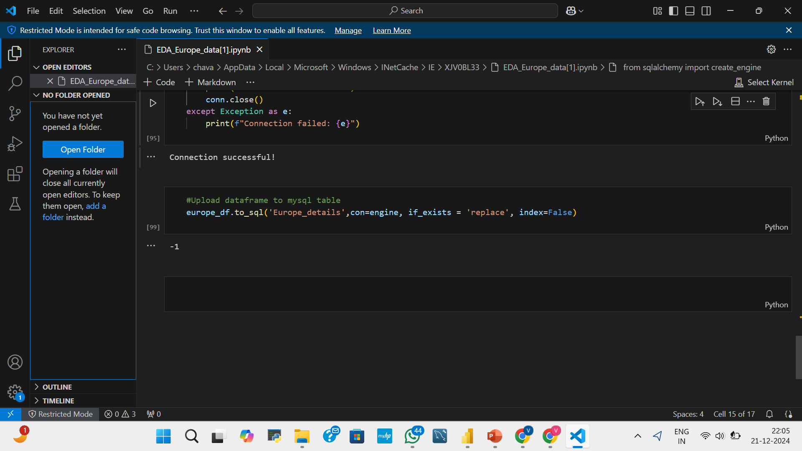
Connection Between Python And SQL

Slide 5
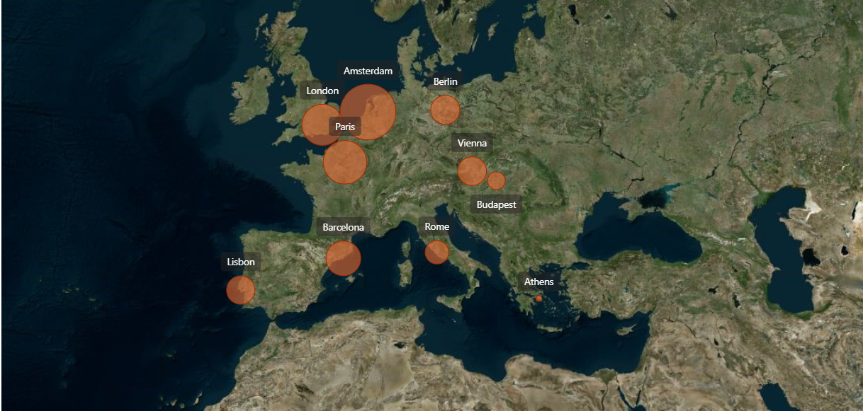
Geographical Insights
From the map we see the distribution of average price of the hotels across different cities in Europe, the bigger the bubble size the higher the average price. So as we can see Amsterdam have the highest average price and Athens have cheapest average price.

Slide 6
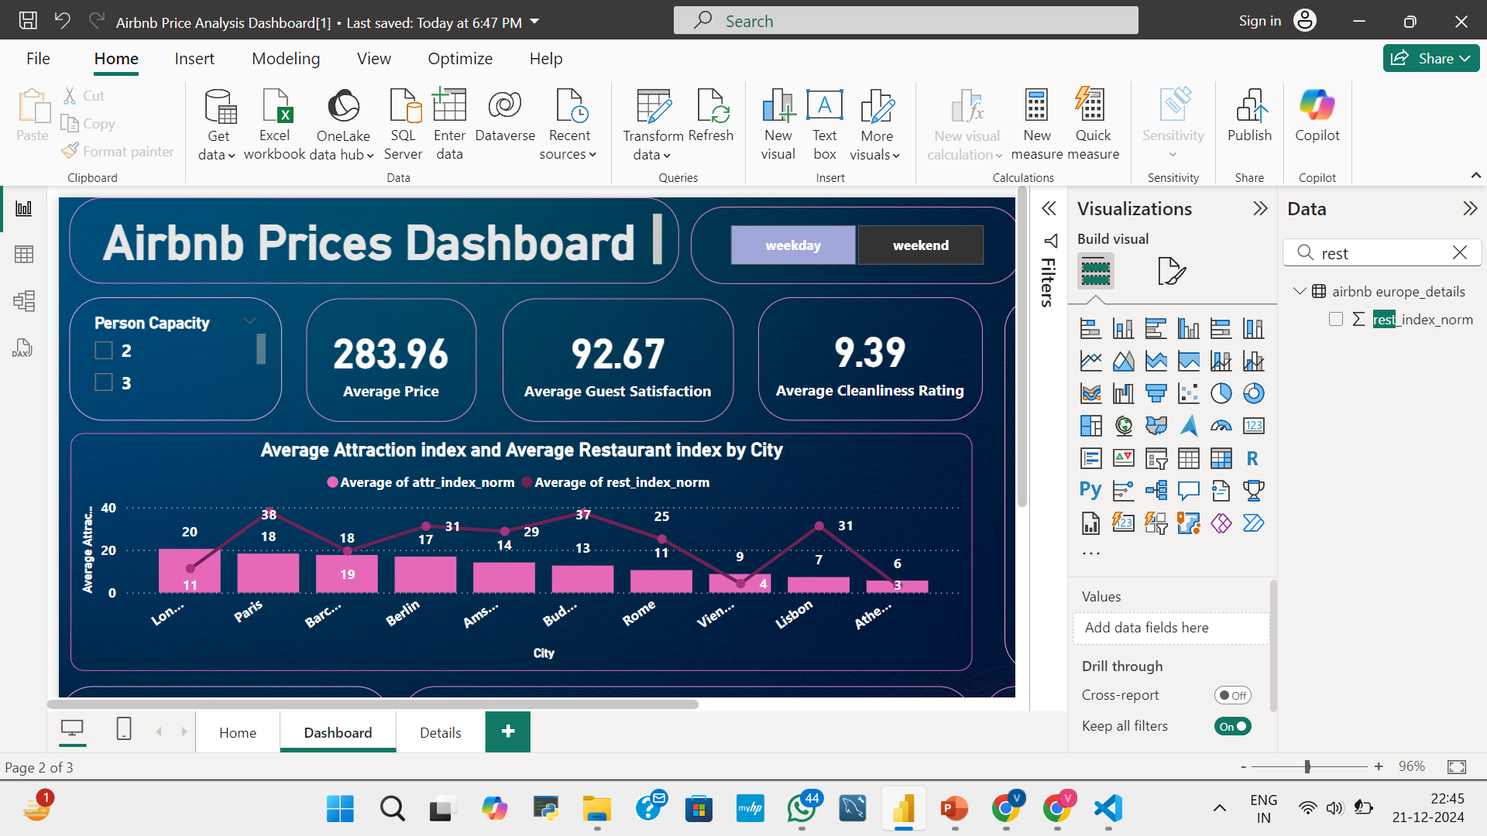
Attraction and Restaurant index by city
From the above visualization we get the Average Attraction Index and Average Restaurant Index by city , both factors depend on whether it is a weekday or a weekend. During the weekend , London has the highest Average Attraction Index among all cities, with a value of 20, while Paris has the highest
Average Restaurant Index, with a value of 38.

Slide 7
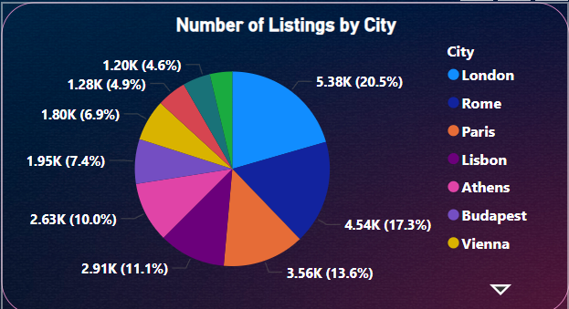
Number of Listing by City
In the Number of Listings by City, London has the highest share compared to other cities, with a value of 20.5%, followed by Rome at 17.3%. This factor influences the Average Attraction Index and Average Restaurant Index, which explains why London has the highest Average Attraction Index. Additionally, it impacts the average price based on room types and cities.

Slide 8
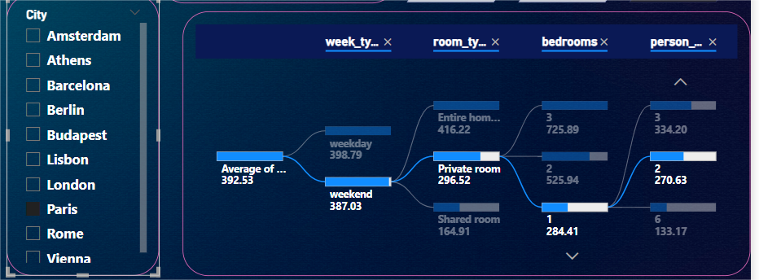
Average Price Identification:
Let’s take a scenario that you want to book a hotel in Paris,
From the above visualization, we can use this slicer and decomposition tree we can get the average price of room for weekend, private room, 1 bhk, 2 person capacity as 271 euros approximately which is very helpful for planning our budget while travelling.

Slide 9
Summary
Examining the Airbnb dataset reveals significant insights into the platform's services, location-based trends, and host behaviors. These observations can support strategic planning for Airbnb and its users, such as refining pricing models, enhancing marketing initiatives, and optimizing host performance. We analyze that how to listing influence on the prices of rooms and city and also influenced by average attraction index and average restaurant index and guest satisfication. We analyze how listings impact room prices and city trends, which are further influenced by the Average Attraction Index, Average Restaurant Index, and guest satisfaction levels.

